Slide 1
Stack - Data Structure

Slide 2

What is Stack
A stack is an Abstract Data Type (ADT), commonly used in most programming languages. It is named stack as it behaves like a real-world stack, for example – a deck of cards or a pile of plates, etc.
Stack Example

Slide 3
Stack Data Structure
Stack is a linear data structure which follows a particular order in which the operations are performed. The order may be LIFO(Last In First Out) or FILO(First In Last Out).
Mainly the following three basic operations are performed in the stack:
Push: Adds an item in the stack. If the stack is full, then it is said to be an Overflow condition.
Pop: Removes an item from the stack. The items are popped in the reversed order in which they are pushed. If the stack is empty, then it is said to be an Underflow condition.
Peek or Top: Returns top element of stack.
isEmpty: Returns true if stack is empty, else false.
isFull() − check if stack is full.

Slide 4
Applications of stack:
Balancing of symbols
Infix to Postfix /Prefix conversion
Redo-undo features at many places like editors, photoshop.
Forward and backward feature in web browsers
Used in many algorithms like Tower of Hanoi, tree traversals, stock span problem, histogram problem.
Other applications can be Backtracking, Knight tour problem, rat in a maze, N queen problem and sudoku solver
In Graph Algorithms like Topological Sorting and Strongly Connected Components

Slide 5
Time Complexities of operations on stack:
push(), pop(), isEmpty() and peek() all take O(1) time. We do not run any loop in any of these operations.
Implementation: There are two ways to implement a stack:
Using array
Using linked list

Slide 6
Algorithm of peek() function
begin procedure peek
return stack[top]
end procedure

Slide 7
Algorithm of isfull() function
begin procedure isfull
if top equals to MAXSIZE
return true
else
return false
endif
end procedure

Slide 8
Algorithm of isempty() function
begin procedure isempty
if top less than 1
return true
else
return false
endif
end procedure

Slide 9
Push Operation
The process of putting a new data element onto stack is known as a Push Operation. Push operation involves a series of steps −
Step 1 − Checks if the stack is full.
Step 2 − If the stack is full, produces an error and exit.
Step 3 − If the stack is not full, increments top to point next empty space.
Step 4 − Adds data element to the stack location, where top is pointing.
Step 5 − Returns success.

Slide 10
Algorithm for PUSH Operation
begin procedure push: stack, data
if stack is full
return null
endif
top ← top + 1
stack[top] ← data
end procedure

Slide 11
Pop Operation
Accessing the content while removing it from the stack, is known as a Pop Operation. In an array implementation of pop() operation, the data element is not actually removed, instead top is decremented to a lower position in the stack to point to the next value. But in linked-list implementation, pop() actually removes data element and deallocates memory space.
A Pop operation may involve the following steps −
Step 1 − Checks if the stack is empty.
Step 2 − If the stack is empty, produces an error and exit.
Step 3 − If the stack is not empty, accesses the data element at which top is pointing.
Step 4 − Decreases the value of top by 1.
Step 5 − Returns success.

Slide 12
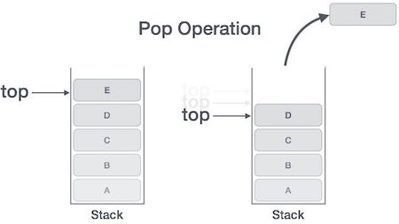
Pop operation

Slide 13
Algorithm for Pop Operation
begin procedure pop: stack
if stack is empty
return null
endif
data ← stack[top]
top ← top - 1
return data
end procedure

Slide 14
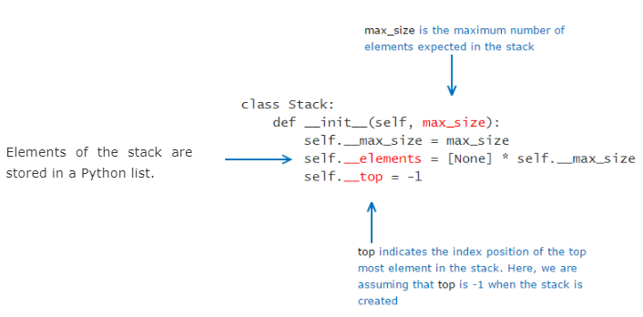
STACK Creation in Python

